Slide 1

Introduction to Azure IoT Edge

Slide 2

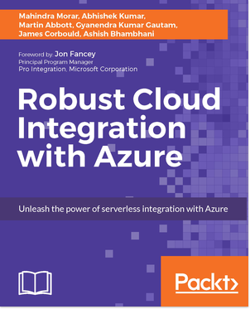


Presenter
James Corbould
Development Team Lead, Integration & IoT
@jamescorbould
https://www.linkedin.com/in/james-corbould-b0073538/
Integration & IoT blog: https://jamescorbould.wordpress.com/

Slide 3
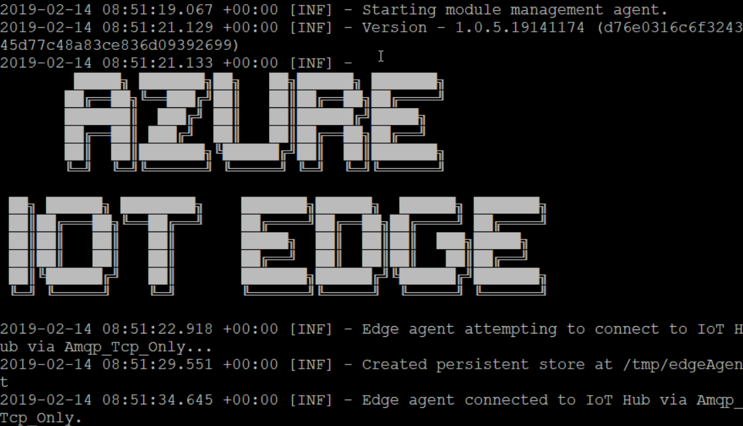
Agenda
Azure IoT Edge
What is IoT?
What is edge computing?
Getting started with Azure IoT Edge
Demo!!
Questions?

Slide 4
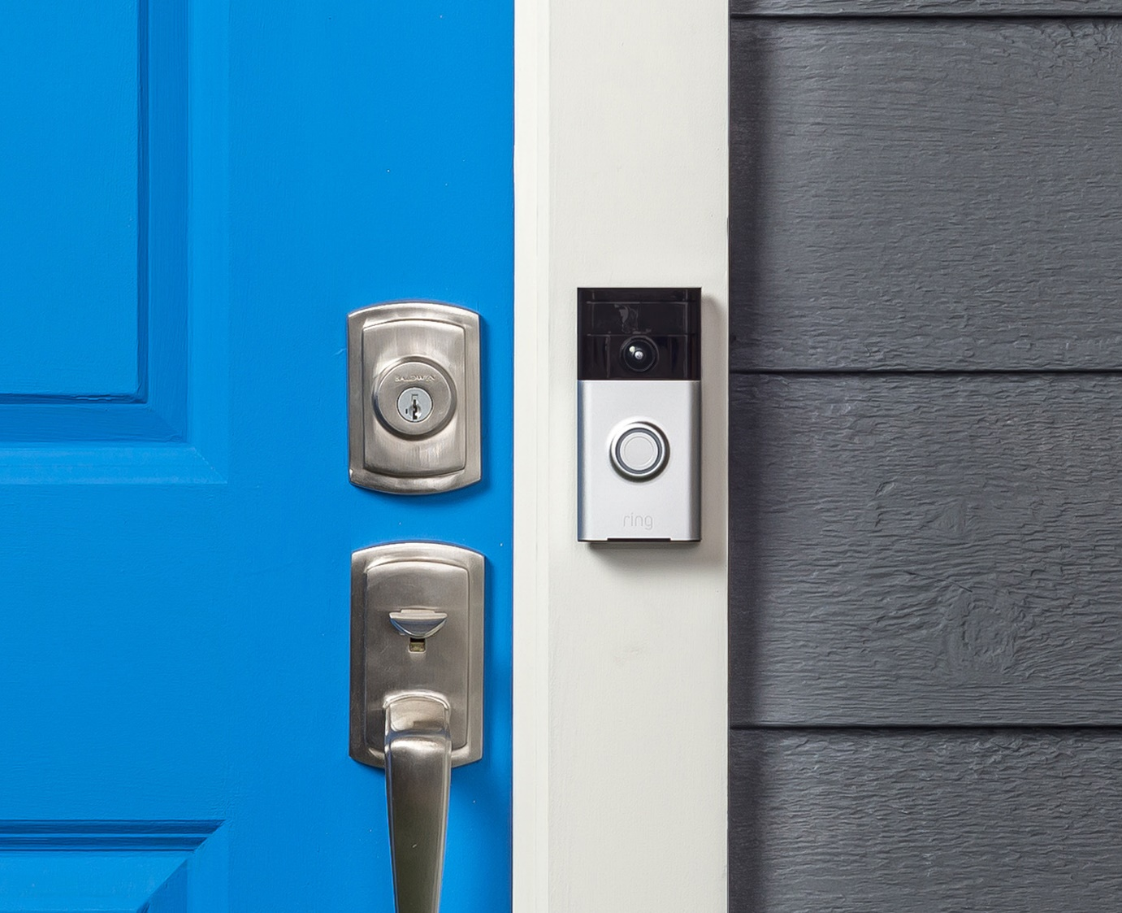

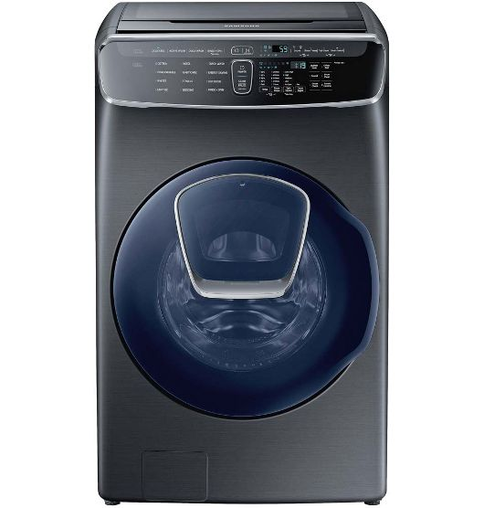
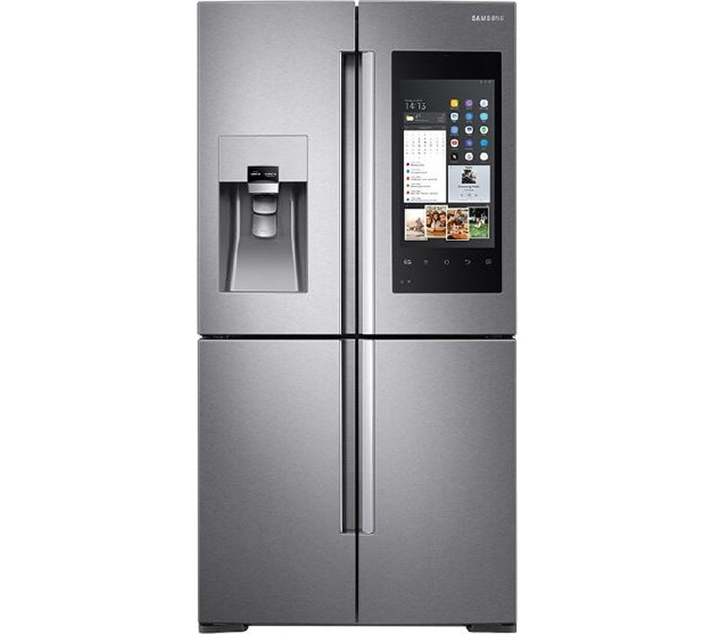
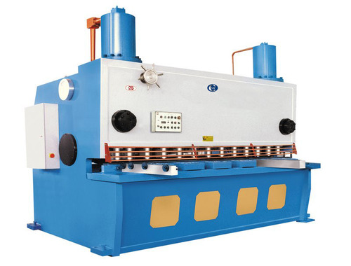
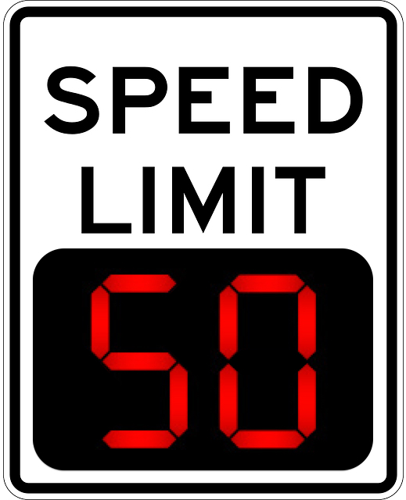
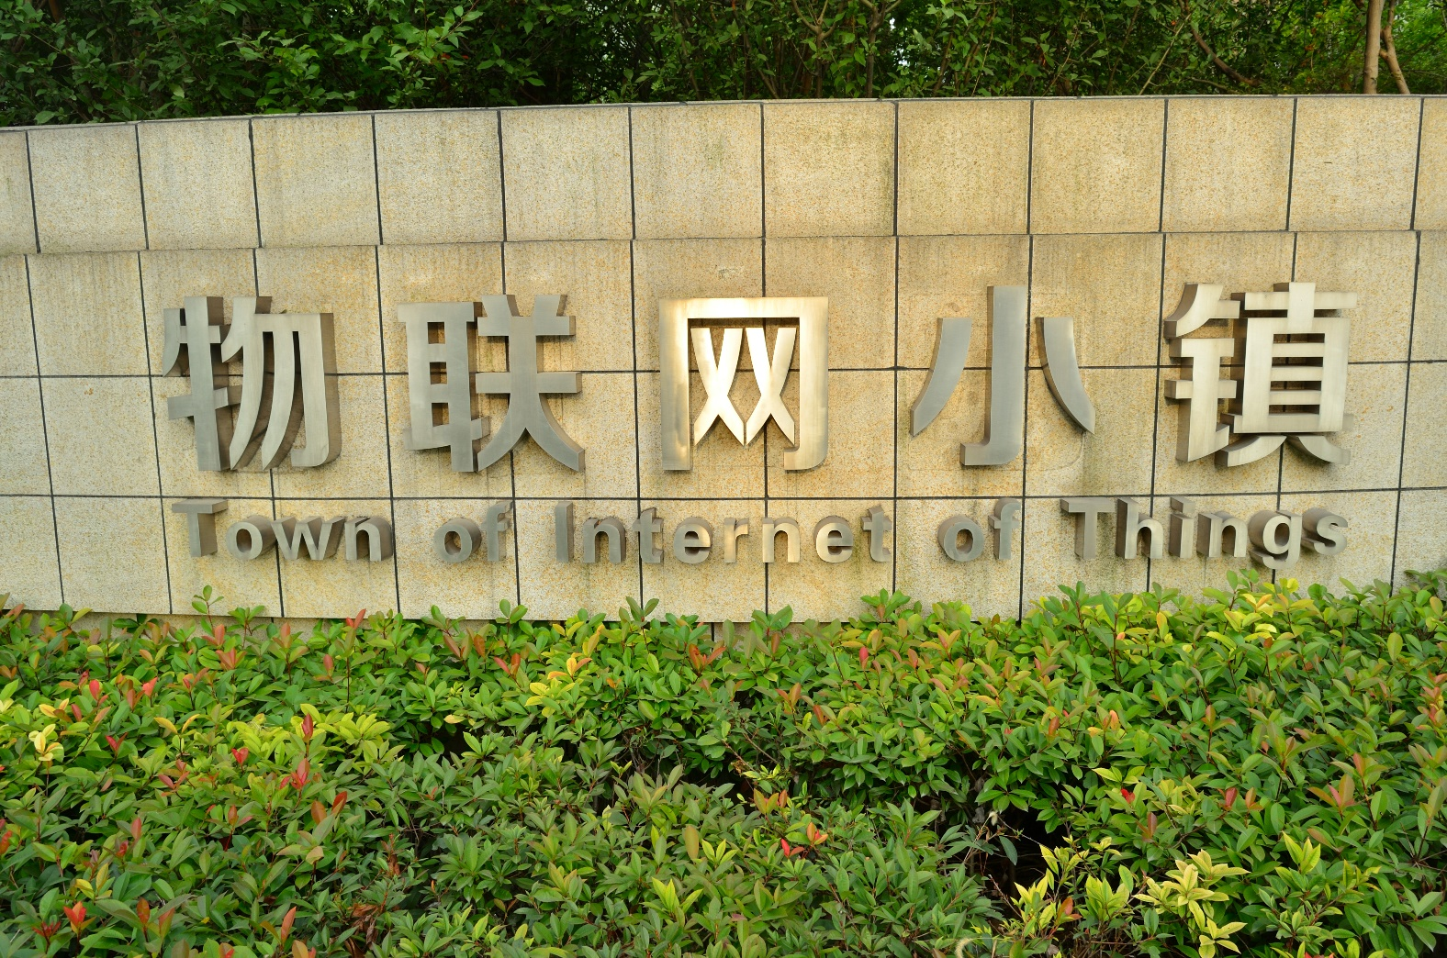
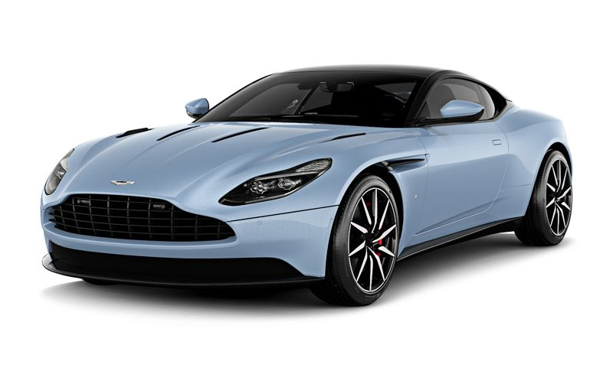
What is IoT?
Notes:
What is IoT?
** Describes how devices communicate with each other and a central hub over the internet **
Devices that collect and transmit data over the internet. Sensors connected to the devices are a very common way to collect data.
Network of smart connected devices using internet for communication.
Extending internet connectivity to traditionally “dumb” or non internet enabled physical devices and everyday objects.
First coined in 1999 – tracking lipstick and it’s supply.
Or internet protocols to communicate with each other and central hub.
This idea been around a long time e.g. 1950s SCADA.
Coke vending machine in 1982 – first internet connected device.
It’s about the data.
Also devices communicating with each other – responding and processing events. So the device can be “smart” in an automated way and react to it’s surroundings.
Network of smart devices.
Automation.
Need a hub – central place where messages can be routed correctly and data can be analysed at scale. Or device-to-device communication.
Organizations look to big data solutions to solve the classic problem of how to discover the hidden gems of useful and meaningful information in their data.
Cloud computing is a major enabler - driven by cheap cloud storage that makes IoT possible where large amounts of data can be received, stored and processed.
Benefits to society – where technology can make a difference. Might allow more freedom and quality of life for those with disabilities or injuries, for example.
Worries about Big Brother! Government monitoring etc. Security.
On the battlefield – be able to know stats about each soldier if his equipment emits data e.g. how many rounds left, status of his equipment etc., heartrate, predict fatigue level and hence ability to function. Make better decisions based on IoT devices on the battlefield. To give an edge. This would need to involve real time accurate data acquisition and processing to make instant decisions.
Gartner estimates that by 2020 there will be over 25 billion connected devices, and some believe that the number will be even higher.
Businesses are using the data generated by these devices to create tremendous business value through the analysis of this data.
Example – steel cutting machines, work out if the machine is used efficiently. Make decisions based on hard data/metrics rather than opinion or gut feel.
What I enjoy personally about IoT is that it touches on a wide range of problems – electronics design, firmware, software engineering, ML & AI, infrastructure, messaging etc. And even ethical and moral questions about the pervasiveness and usefulness of technology. Will/does IoT enrich my life?? E.g. IoT town in China!

Slide 5
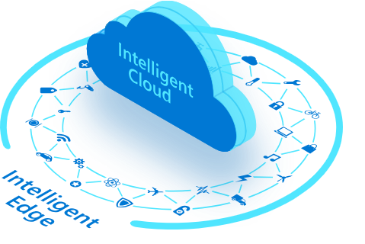
Image source: https://azure.microsoft.com/en-us/overview/future-of-cloud/?site=mscom_iot
Notes:
What is edge computing?
Data processing takes place locally (as close to the action as possible, at the network edge on leaf devices) on the physical device to enable quicker response times to emergencies (for example) and to avoid having to send large amounts of raw data up to the cloud.
Data cleaning and aggregation takes place locally and then data is sent to the cloud for analysis.
Ensure lowest latency possible between the data and the decision.
Process data locally and send only what’s needed to the cloud for further analysis. Reduces cost and keeps data quality high.
Edge device can operate even when no or intermittent access to the cloud.
Avoids latency of all data processing having to take place in the cloud.
Reduces transmission and data storage costs.
Device can interact more readily with events that take place in the physical world.
What processing could take place “on the edge”?
Stream analytics.
Machine learning models run on the data locally, rather than in the cloud. Greater/better response times to events.
Pre processing and batching of data before sending to the cloud.
Could be used as a gateway that on-prem leaf devices connect too. The gateway then carries out some processing locally and pushes data to the cloud.

Slide 6
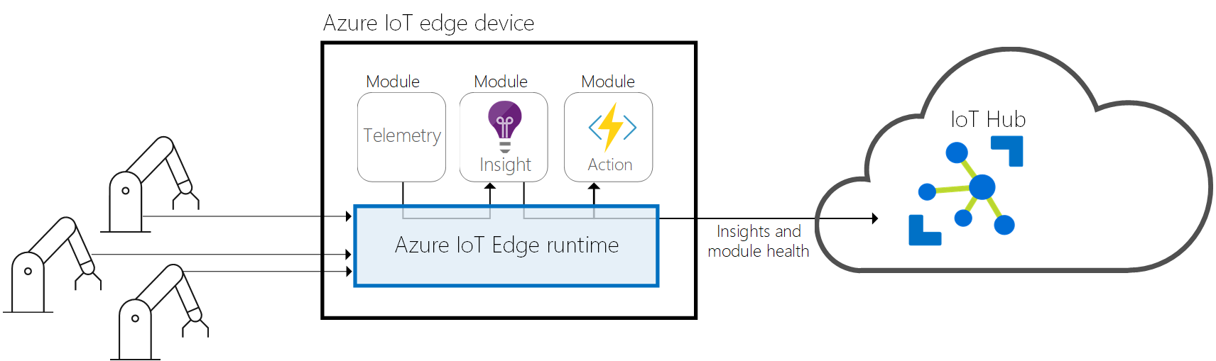
IoT Edge Runtime
Image source: https://docs.microsoft.com/en-us/azure/iot-edge/about-iot-edge
Notes:
Intro to Azure IoT Edge #1
Modules can be custom, developed in a language and framework of your choice e.g. .NET core 2.0 with C#.
Also can use pre built modules that can be downloaded from the Azure marketplace.
Azure IoT Edge runtime
IoT Edge Hub – acts as a local proxy for IoT Hub.
If connection to IoT Hub is lost, Edge Hub will store messages until connectivity is restored and will sync data when connection is restored.
Acts as a message broker so keeping modules independent from each other.
Define rules for how edge hub should route messages between modules.
Routing rules are defined in the cloud via deployment manifest for that device in it’s device twin and pushed down to the actual device.
IoT Edge Agent
Create modules, providing a runtime environment and reports back on status to edge hub.
Security – verifies a modules image before starting it.

Slide 7
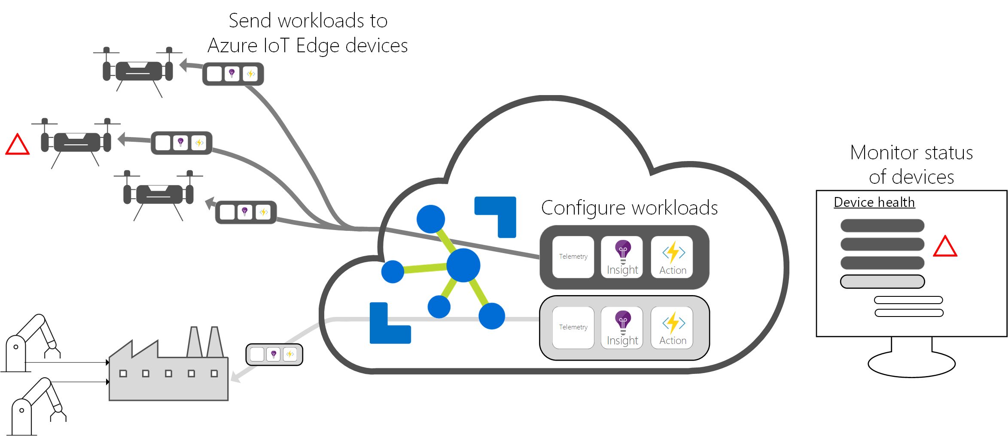
IoT Edge Cloud
Image source: https://docs.microsoft.com/en-us/azure/iot-edge/about-iot-edge
Notes:
Intro to Azure IoT Edge #2
Use IoT Hub to monitor health of modules running on devices and configure deployments at scale e.g. deployment manifests.
IoT Hub data ingestion.

Slide 8
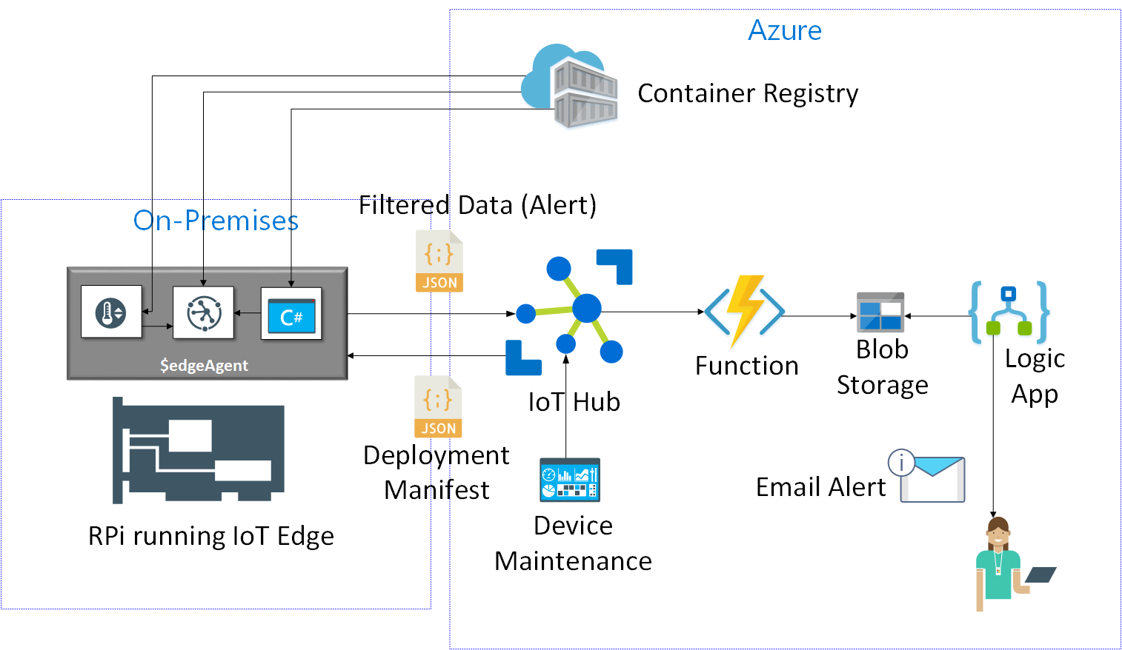
Demo Overview
Notes:
Intro to Demo #1
High level diagram.
Can download public images from Microsoft container registry and/or those from own personal registry.
Deployment registry declares which modules the IoT Edge runtime will install on your IoT Edge device.

Slide 9
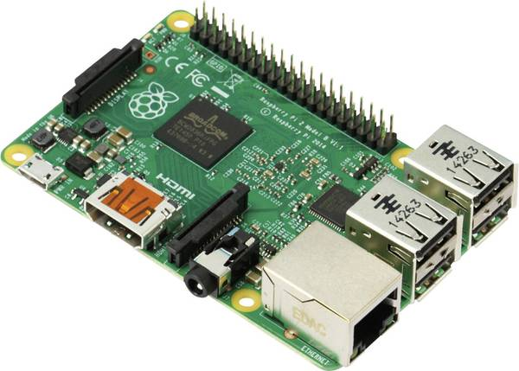
Notes:
Intro to Demo #2
Intro to RPi used in demo.

Slide 10
Demo!!

Slide 11


Reference Material
Azure IoT Edge official pages:
https://azure.microsoft.com/en-us/services/iot-edge/
https://docs.microsoft.com/en-us/azure/iot-edge
Azure IoT school learning (hands on labs):
https://iotschool.microsoft.com/en-us/home
IoT Edge OSS project on GitHub:
https://github.com/Azure/iotedge
Presentation demo code on GitHub:
https://github.com/jamescorbould/IoTEdgeTest

